Slide 1
Banking System Design Phase
James Cazares, Sirpreet Kaur, Amanual Wolde, Diego Castaneda, Khalil Cato

Slide 2
Quick Reminder About Requirements
Members can: - Withdraw - Deposit - Transfer Money - Hold Multiple Savings/Checkings Accounts
Employees can help members: - Open Accounts - Close Accounts - Check Logs Regarding Accounts/Member Activity
ATM’s can handle member requests to: - Withdraw - Deposit - Check Balance
Two GUI interfaces, one for ATM, one for the teller

Slide 3
Most Significant Objects/Classes
We believe the 5 most important objects/classes for the banking system to be (in no order):
Member - Used for holding member data such as account number, pin, personal information
Banking System - To handle withdrawal/deposit requests as well as several other methods
Account - Specifies a checkings or savings account with a balance
ATM/Employee - Handles member requests using banking system methods (acts as interface)
Debit Card - For easier account access/identification

Slide 4
Features of main classes
Bank System Class:
Variables:
-bankLogs
-ip
-portNumber
Methods:
-deposit()
-withdraw()
-checkBalance()
-validateCard()
-createAccount()
-closeAccount()
-updateMemberDetails()
-checkAccountLogs()
-checkStatement()
-connectToATM()
-connectToEmployee()
-checkMemberDetails()
-logAction()

Slide 5
ATM class
Variables:
-idNumber
Methods:
-validateCard(): to check the user identity
-uses deposit() : deposits money to customer’s account
-uses withdraw(): withdraws the requested amount
-uses checkBalance(): checks customer’s account balance
-printReceipt(): prints out the transaction summary

Slide 6
Employee class
Variables:
-employeeNumber
-employeePassword
Methods:
-uses createAccount(): opens account for new customer
-uses closeAccount(): close the requested existing account
-uses updateMemberDetails(): to update details of bank customer
-uses checkMemberDetails(): to check requested account details
-uses deposit(): to make deposit to requested account number
-uses withdraw(): to withdraw requested amount from cust. Account
-uses checkBalance(): to check customer bank balance
-uses checkStatement(): to check customer statement
-uses checkAccountLogs(): to check login history for the customer

Slide 7
Design Decisions:
Each member gets an array/list for holding unlimited saving and checking accounts
Each account will point to one member and hold its own balance
Banking System will handle all account creation and withdrawal/deposit requests
Employees/ATMs will use the banking system methods to handle member requests
Since each member holds their own account data, removing and adding members/accounts will be easy and not affect other members

Slide 8
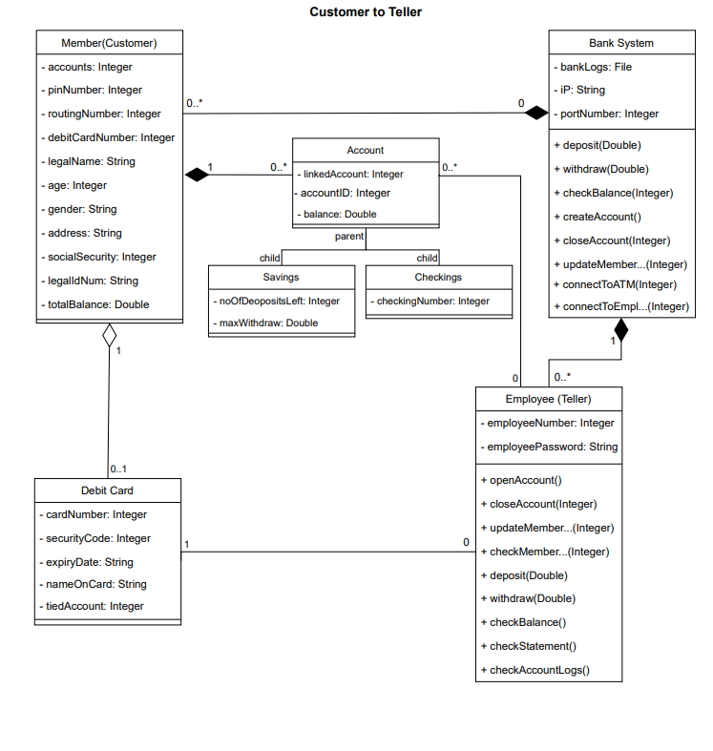

Slide 9
